Slide 1
Image Editor
Mini Project II (Phase 1)
Group members:
Rahul Tandel – 2019130063
Omkar Padir – 2019130046
Sumit Thakare – 2020301079
Guided By Prof. Pramod Bhide

Slide 2
Problem definition:
We used many image editors which provide ample tools to edit image, but very few provide image detection in them. Few who provide are expensive to use. In this growing open source world we want to add our project that has many things in different.
The project aims at developing the image editor using some image processing libraries in python such as pillow, OpenCV. This would be a small application which lets the user to manipulate digital images using tools such as color adjustments, sharpening, zoom, rotation, print etc., additionally we are also providing face detection in our application. Efficient GUI has been provided using tkinter which would allow user access this tools.

Slide 3
Literature survey
For GUI using tkinter: this video has covered the tkinter python. Using this and as we need we are planning to build gui for our application. : https://www.youtube.com/watch?v=YXPyB4XeYLA
OpenCv tutorial from youtube: opencv will be main backbone of these editor. : https://www.youtube.com/watch?v=oXlwWbU8l2o
Deepfake detection research paper: https://arxiv.org/pdf/2003.08645.pdf
Face Detection : https://drive.google.com/drive/folders/1CSUR-c8W4f-Q10cUhnL5bqumhz0b_JbU
Steganography : https://drive.google.com/drive/folders/1CSUR-c8W4f-Q10cUhnL5bqumhz0b_JbU

Slide 4
OpenCV documentation: https://docs.opencv.org/master/d6/d00/tutorial_py_root.html
tkinter documentation : https://docs.python.org/3/library/tkinter.html
pillow documentation: https://pillow.readthedocs.io/
opencv python documentation: https://opencv-python-tutroals.readthedocs.io/en/latest/
Steganography (blog): https://www.educba.com/what-is-steganography/ https://scialert.net/fulltext/?doi=itj.2004.245.269#:~:text=Steganography%20is%20in%20the%20literature%20(especially%20military)%20also,file%20in%20the%20contents%20of%20another%20file%20[5,6]
https://resources.infosecinstitute.com/topic/steganography-and-tools-to-perform-steganography/

Slide 5
Market survey:
Adobe photoshop
Google photos
Magix photo manager
Apple photos
CyberLink PhotoDirector 12
Corel Aftershot Pro 3
Corel PaintShop Pro 2021

Slide 6
Picasa
GIMP
Pixen
Inkscape
Krita
Photoscape

Slide 7
Scope of work:

Slide 8
02
The editor would have
GUI build using tkinter
User can edit image using
Various image editing tools
It would have face
Detection ability so that we can
Manipulate face data.
We would also add extra
utilities such as steganography,
Image sorting using face data.
01
03
04

Slide 9
Objective
User would be able to edit image using different tools
User can detect faces in images using application and edit its data
Live face detection would also be supported
Creating extra utilities such as, stickers that stay on faces on camera

Slide 10
FEATURES

Slide 11
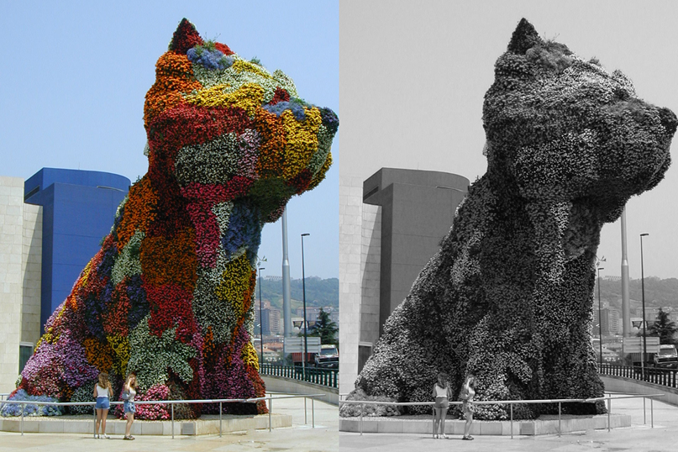
Changing the colour depth

Slide 12
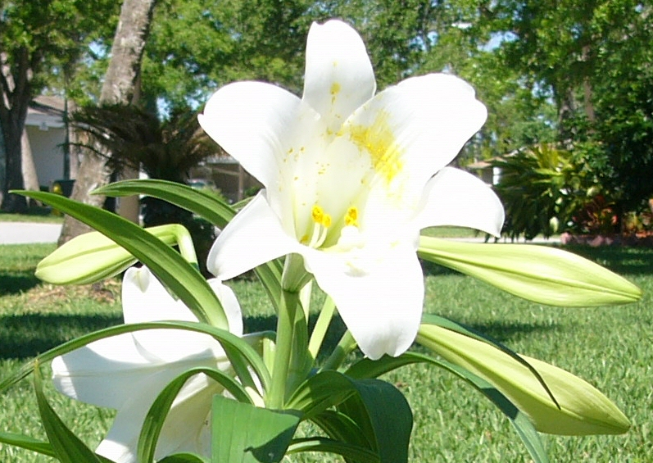
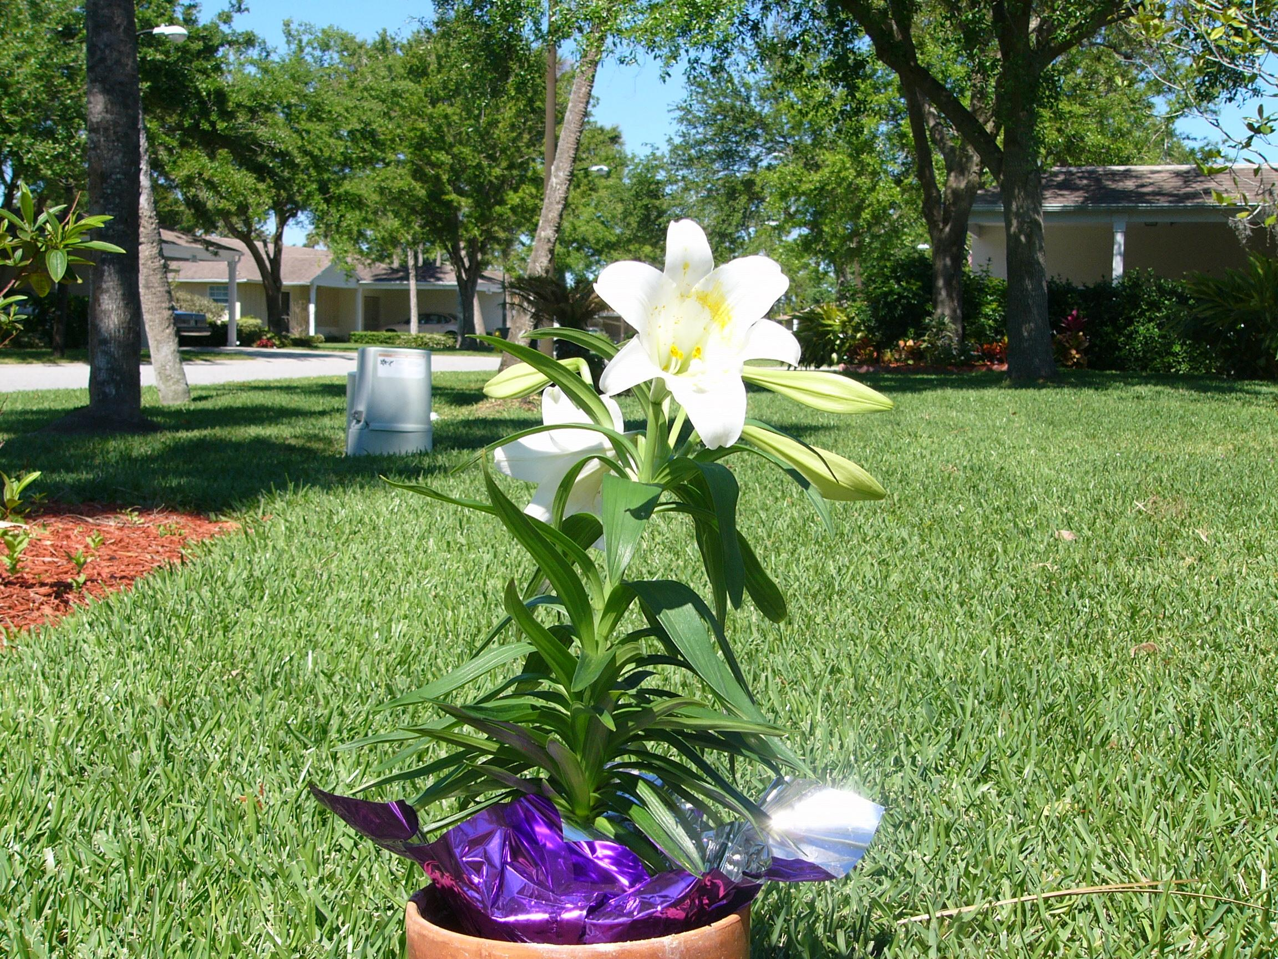
Cropping an image

Slide 13
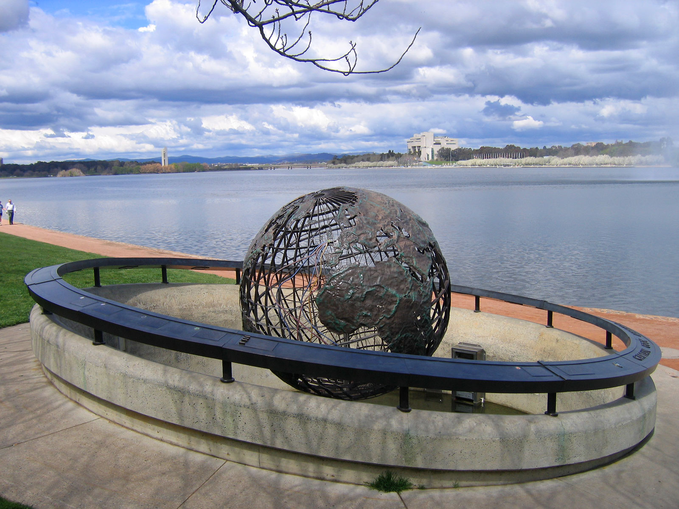
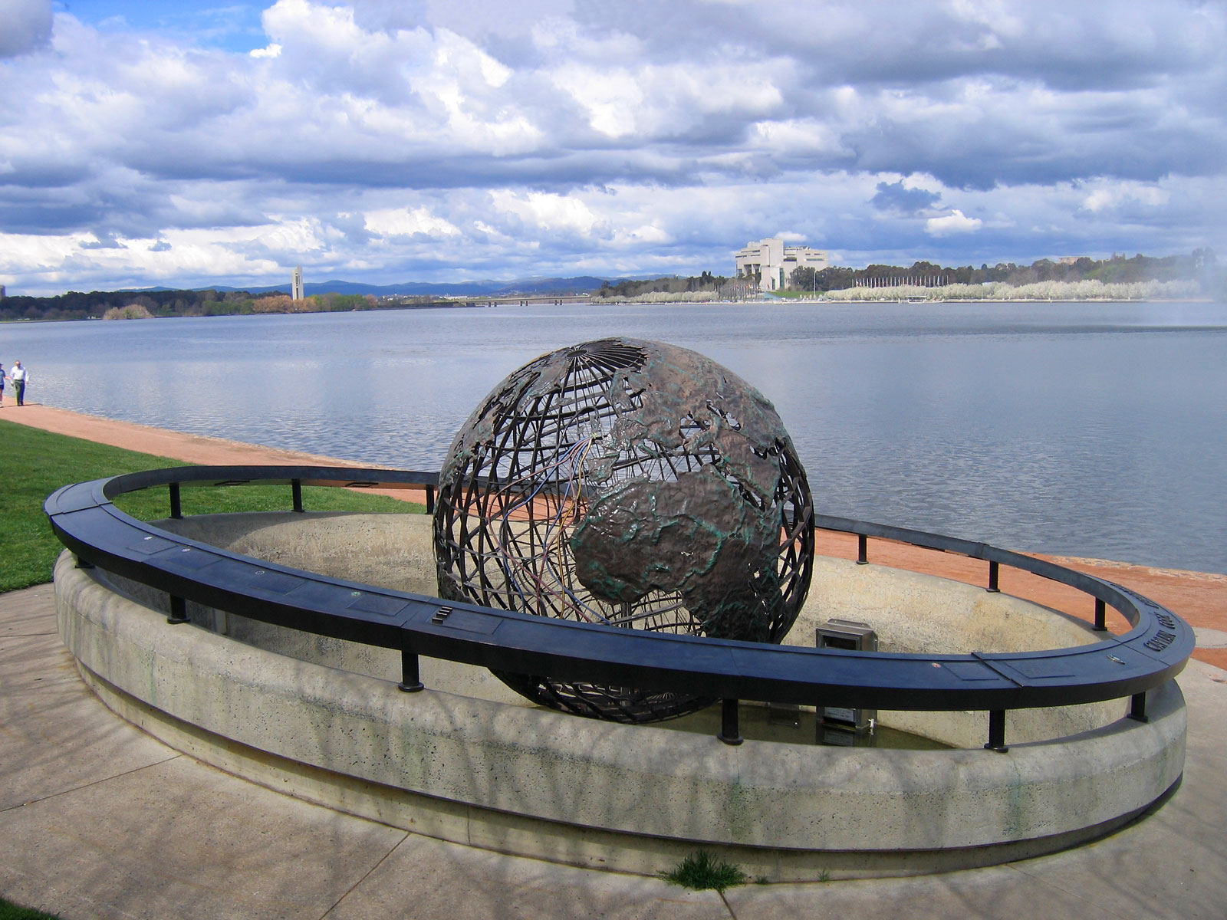
Removal of unwanted elements

Slide 14
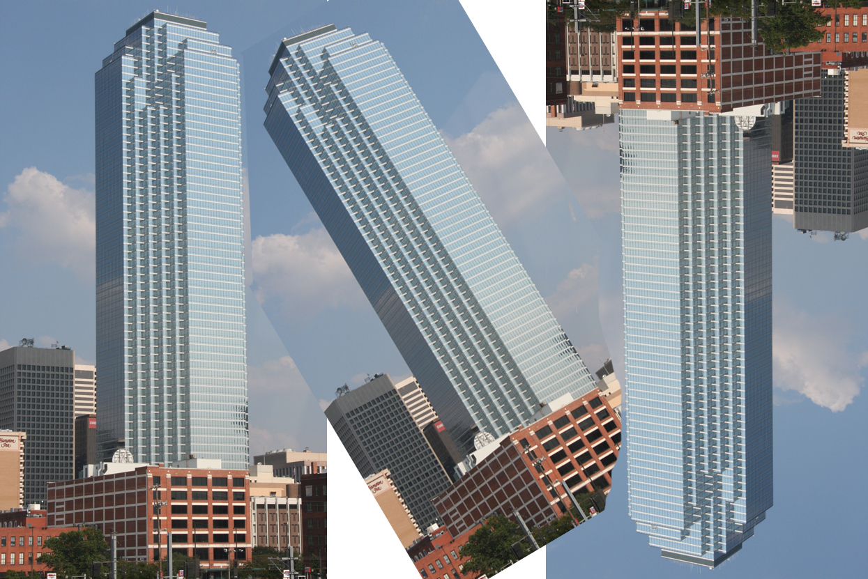
Image orientation

Slide 15
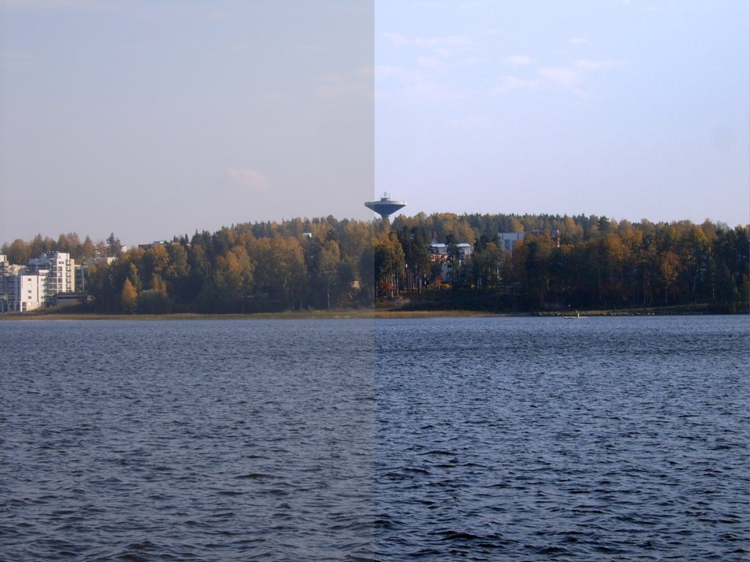
Contrast change and brightening

Slide 16
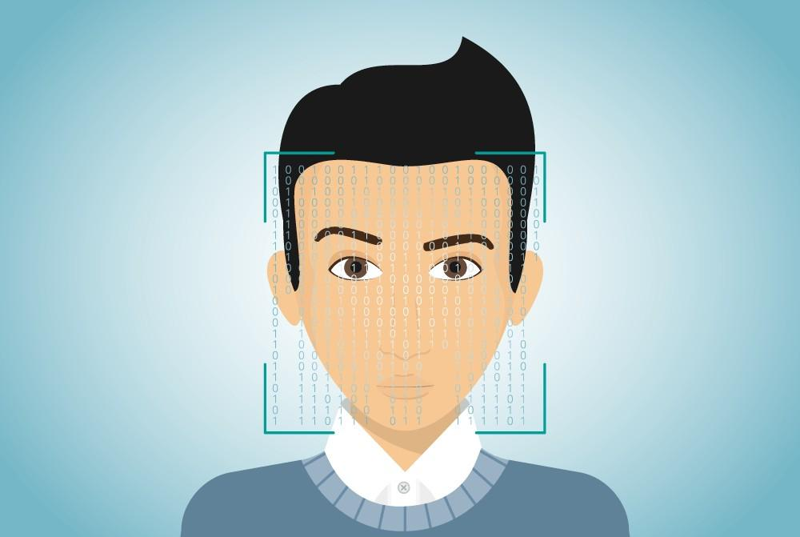
Face detection

Slide 17
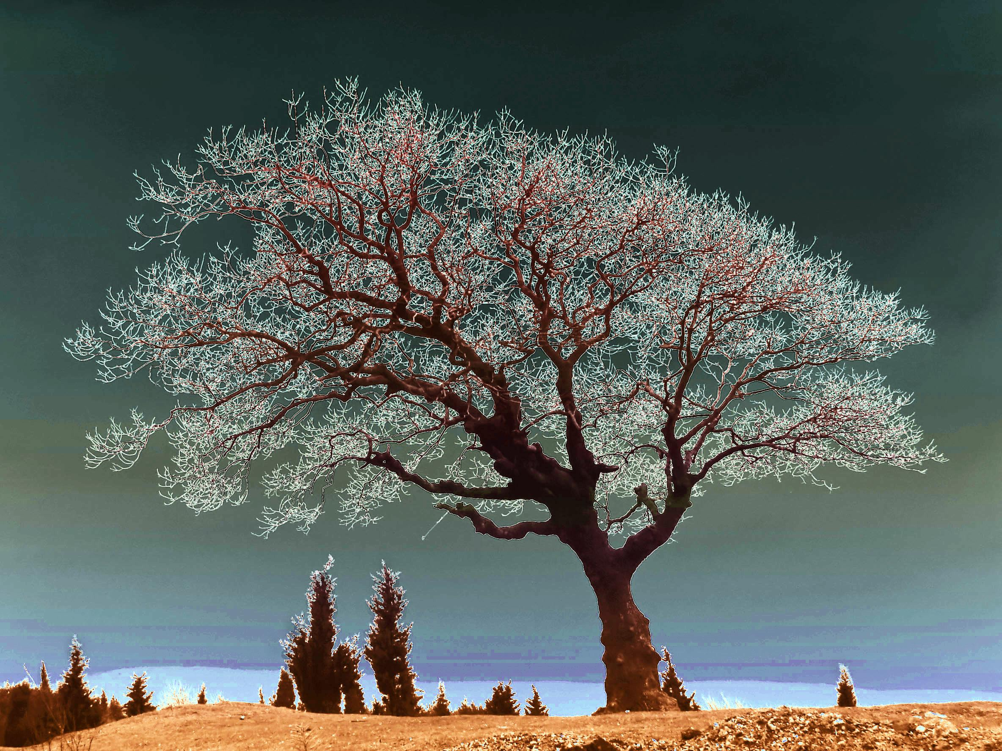
Special effects

Slide 18
Proposed System

Slide 19

Filter manager
GUI
Image loader
Geometry manager
Face detection
Properties manager
Face data manipulation
Extra utility algorithms
Editor memory manager
(undo and redo operations)

Slide 20
Timeline
Week
1 | Image loader , filter manager
2 | Geometry manager ,properties manager
3 | Face detection, steganography
4 | ASCII image creator, colour filler using reference image (cont. in 5th week )
5 | Finishing touches

Slide 21
References
Creating face detection and motion detection using opencv:
Using this we want detect motion in video.
https://www.youtube.com/watch?v=-ZrDjwXZGxI
How to create simple image editor video: https://www.youtube.com/watch?v=gA4Uv6uE0f8&t=1346s
Image Editor using Python : https://www.codershubb.com/build-a-simple-photo-editor-app-using-python/
OpenCV2 : https://www.geeksforgeeks.org/opencv-python-tutorial/

Slide 22
References
Face detection using opencv(blog): Face Detection with Python using OpenCV - DataCamp
Colour detection using opencv in python(blog): Color Detection in Python Using OpenCV : 8 Steps - Instructables
Edge detection of image using opencv: Edge Detection of Image using OpenCV (CV2) in Python (includehelp.com)https://www.geeksforgeeks.org/python-program-to-detect-the-edges-of-an-image-using-opencv-sobel-edge-detection/

Slide 23
Thank you

